Slide 1





A new technology in medicine
Digital twins
Group 7
Gisela de Miguel Garcia, Olivia Dove Estrella,
Oriol Gómez Lores and Roger Parramon Codina

Slide 2
01
INTRODUCTION
02
APPLICATIONS OF DIGITAL TWINS IN THE MEDICAL FIELD
Personalized medicine
Improving healthcare organizations
Drug and medical development
03 ETHICAL ASPECTS
INDEX

Slide 3
Introduction

Slide 4
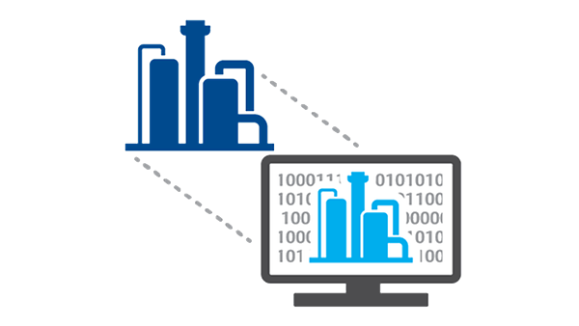
INTRODUCTION AND DEFINITION
DEFINITION:
Digital replica of physical object, process or service.
Pairs physical and digital worlds using modern technologies.
Their goal is test and optimize physical objects virtually.

Slide 5



A LITTLE BIT OF CONTEXT
Dr. David Hillel Gelernter
1990s
Dr. Michael Grieves
2002
2010

Slide 6
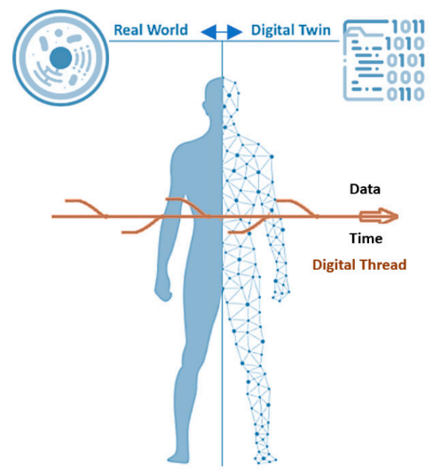
DIGITAL TWINS IN A MEDICINE CONTEXT
The 3 components of a digital twin:
The physical product in the physical space.
The digital representation of the physical product in the virtual environment.
Connection between the two of them.
Figure 1. Composition of a digital twin. Ref: Kamel Boulos, M. N., & Zhang, P. (2021)

Slide 7
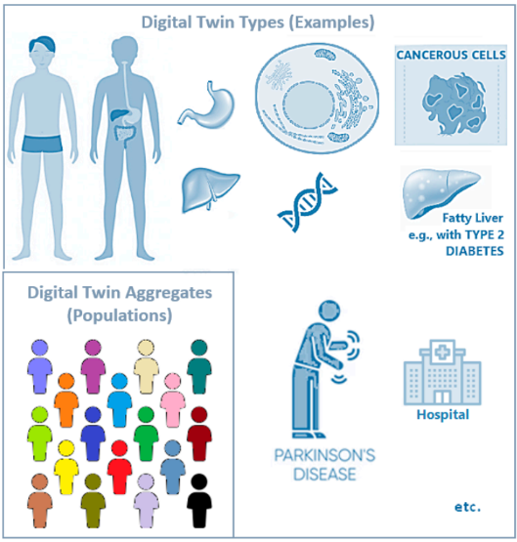
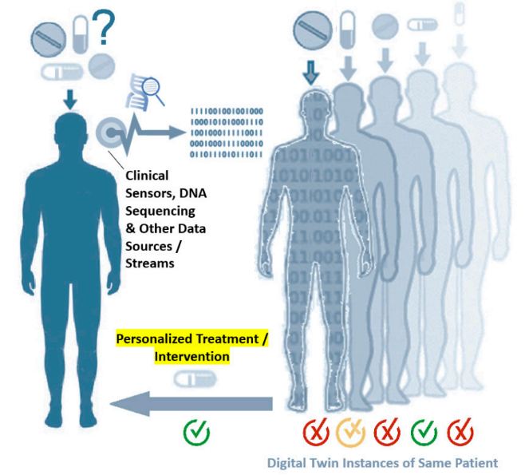
DIGITAL TWINS IN A MEDICINE CONTEXT
Figure 2. Some examples of different types of human digital twins. Ref: Kamel Boulos, M. N., & Zhang, P. (2021)
Figure 3. Summary image of the usability of digital twins in medicine. Ref: Kamel Boulos, M. N., & Zhang, P. (2021)

Slide 8
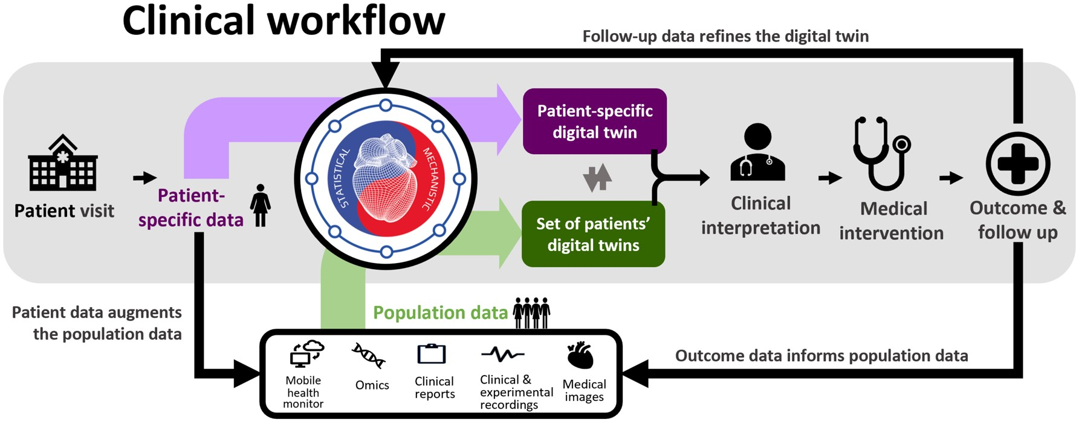
DIGITAL TWINS IN A MEDICINE CONTEXT
Figure 4. Envisioned clinical workflow using the fully developed digital twin concept. Ref: Corral-Acero, J., Margara, F., Marciniak, M., Rodero, C., Loncaric, F., Feng, Y., Gilbert, A., Fernandes, J. F., Bukhari, H. A., Wajdan, A., Martinez, M. V., Santos, M. S., Shamohammdi, M., Luo, H., Westphal, P., Leeson, P., DiAchille, P., Gurev, V., Mayr, M., Geris, L., … Lamata, P. (2020)

Slide 9
02
01
Improving healthcare organisations
Personalized medicine
Applications of digital twins in medicine
03
Drug and medical device development

Slide 10
01
Personalized medicine
Applications of digital twins in medicine

Slide 11
Ineffectiveness
BIOMARKERS
OMICS
Why is personalized medicine necessary?
40 - 70% patients do not respond well to treatment.
Most illnesses are complex, which means, a lot of biomarkers should exist. One a few are analysed.
The ‘omics’ sciences are extremely useful tools which could help choosing the most effective drugs.

Slide 12
What role do virtual twins play here?
Recreate a virtual phenotype.
Test tons of drugs.
Benefits both the patient and hospitals.
SDTC
Digital Twin Creation.
2. Test drugs.
3. Actual treatment.

Slide 13
INCOnVENIENCES
WHAT DO WE NEED TO KNOW?
WHAT IS THE BEST WAY TO INTEGRATE THE INFORMATION WE KNOW?
WHICH CELL TISSUES DO WE NEED TO ANALYZE?
CAN WE EASILY GET TISSUE/CELL SAMPLES?
CAN WE MAKE IT IN TIME?
ARE THE MOLECULAR MECHANISMS TRUTHFULLY AND DEEPLY KNOWN?
ARE THERE IN THE MARKET DRUG THAT CAN TARGET ALL THE MECHANISMS NECESSARY TO CURE?

Slide 14
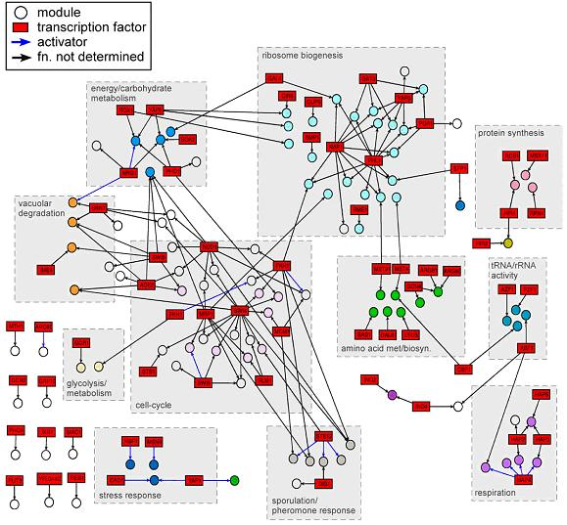
CREATION OF DIGITAL TWINS (I)
Systems biology tools are indispensable.
Network tools like PPI are used in complex biological systems.
Genes can be mapped over proteins, creating modules.
NODES
MULTI-LAYER MODULES
Figure 5. Example of a systems biology web. Ref: http://sb.cs.cmu.edu/Research/ (2012)

Slide 15
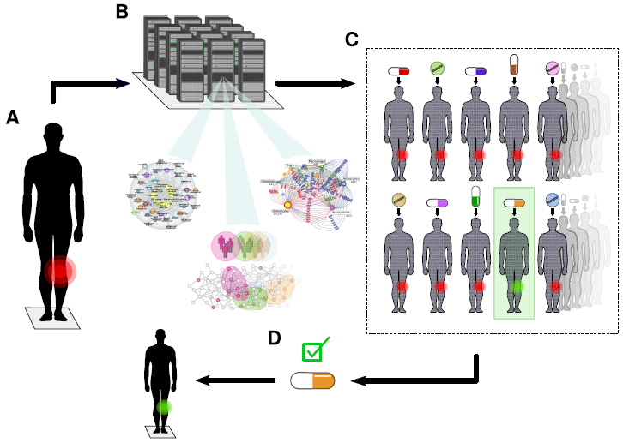
CREATION OF DIGITAL TWINS (II)
Figure 6. Scheme which would be used for digital twins personalized medicine. Ref: Björnsson, B., Borrebaeck, et al. (2019). BioMed Central Ltd. https://doi.org/10.1186/s13073-019-0701-3

Slide 16
HOW TO EXPAND DIGITAL TWINS?
DIRECTING TREATMENTS TO OTHER TARGETS
MORE FIELDS OF INFORMATION
DYNAMISM OF NETWORKS
Rather than just molecular traits.
Environmental factors.
Symptoms.
Sometimes the causal tissues are not associated with symptoms.
Many illnesses like cancer do not show symptoms until advanced development.
Machine learning.
Deep learning.
Artificial intelligence.
DIGITAL TWIN OPTIMIZATION

Slide 17
02
Improving healthcare organisations
Applications of digital twins in medicine

Slide 18
hEALTHCARE ORGANIZATIONS
CLINICIANS
PATIENTS
Increased accuracy Rejecting/Validating treatment
COVID-19 situation
Reducing infection risk
Higher involvement Rejecting/Validating treatment
Better feedback
Intuitive app interface
Clear data visualization, simple language

Slide 19
Applications of digital twins in medicine
03
Drug and medical device development

Slide 20




MEDICAL DEVICES DESIGN AND OPTIMIZATION
✔ Security and safety
✔ Effectiveness
✔ Optimization
✔ ⬇⬇ Cost and time
✔ Monitor maintenance
✔ Meet legal requirements
Genetic data
Laboratory studies
Imaging studies
Biomedical data
Social determinants
Human
Digital twin
Physical properties
Algorithms
Maintenance history
Sensor data
Performance metrics
Environmental factors
Medical device
Digital twin
Figure 7. Digital twins in medical devices design and optimization. Ref: Adapted from (Kesari 2021)

Slide 21
DRUG DESIGN AND OPTIMIZATION
✖ 50,000 chemical compounds are tested
✖ Only 1 in 12 drugs arrive successfully to the market
✖ Drug failures due to toxicity and efficiency
Drug design is extremely research-intensive, long and expensive.

Slide 22
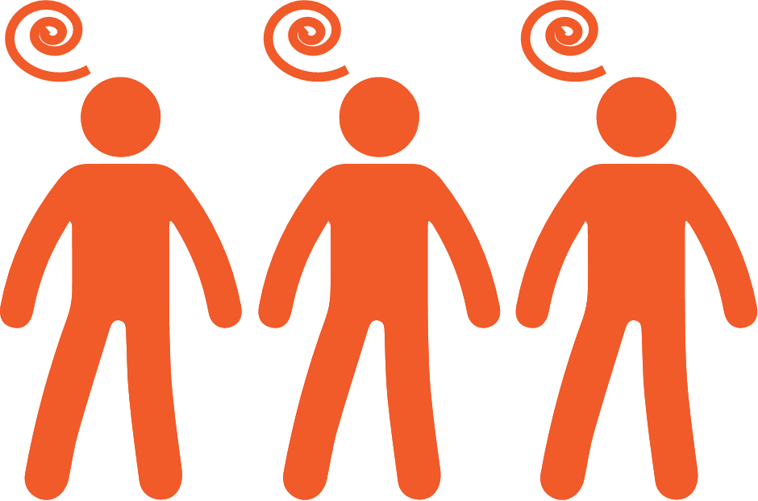
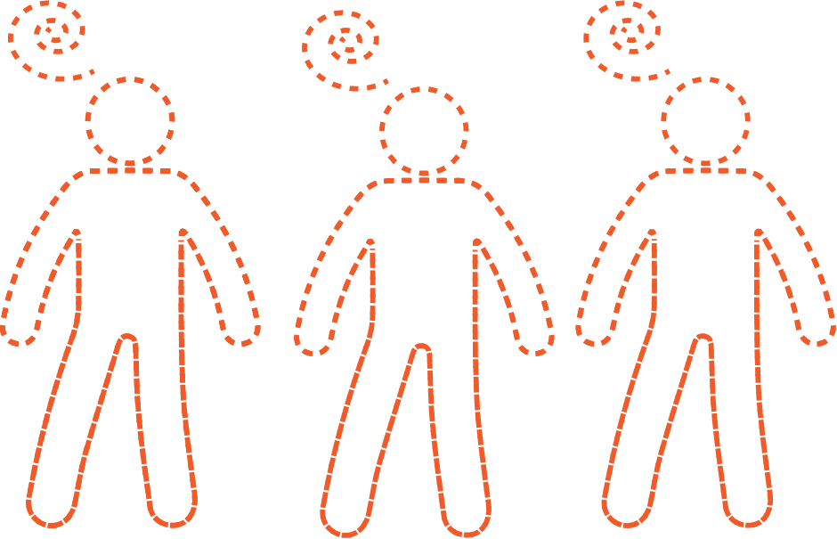
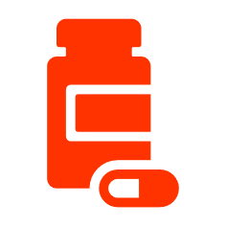
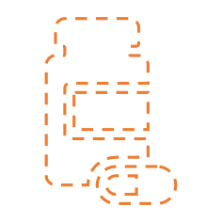
DRUG DESIGN AND OPTIMIZATION
✔ Predict the best novel candidate
✔ Effectiveness
✔ Optimization
✔ ⬇⬇ Cost and time
✔ Optimal dosage
✔ Indications
✔ Conivence
Cohort of humans with shared symptoms
Digital twin
Novel drug
Digital twin

Slide 23
CLINICAL TRIALS
✖ Not an accurate representation of the real world | ✔ Coverage
✖ Problems recruiting the patients on time | ✔ Speed
✖ Not every patient is treated by a trial’s new drug (placebo) | ✔ Predictability
✖ Safety issues | ✔ Safety

Slide 24
02
01
Racial and gender bias
Misuse of the data
Ethical aspects
03
Better public knowledge

Slide 25
01
Misuse of the data
Ethical aspects

Slide 26
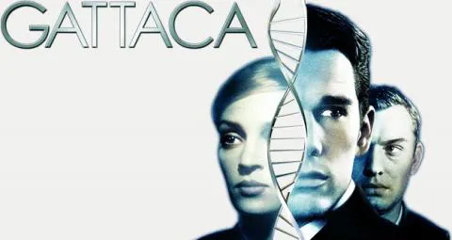


MISUSE OF THE DATA
Possibility of abuse by external entities
Using data against the patients’ best interests
Twisting the intended use of a digital twin
Root of most of the ethical conflicts
❌ Don’ts
Denying job offers
Raising insurance prices

Slide 27



MISUSE OF THE DATA
✔ Do’s
Ownership of the data
Explicit informed consent
Anonymity of public data
Strong legal support

Slide 28
02
Racial and gender bias
Ethical aspects

Slide 29
RACIAL AND GENDER BIAS
Perpetuating and intensifying historical bias
Originated by biased datasets
Identifying the origin of the bias

Slide 30
Ethical aspects
03
Better public knowledge

Slide 31
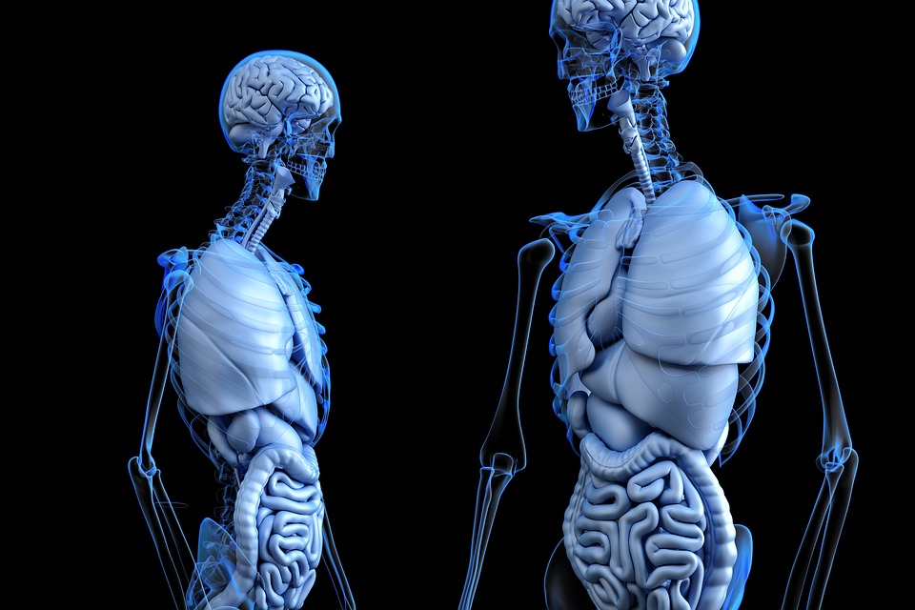
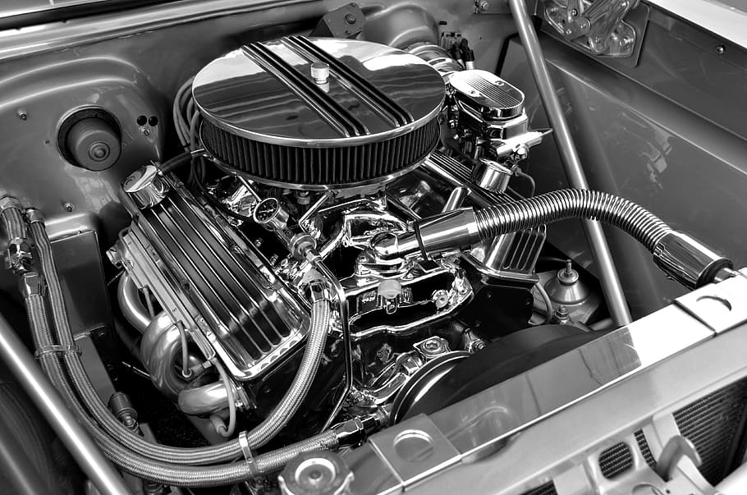
Better Public KNOWLEDGE
Allowing patients to weight costs and benefits
Potentially avoid paternalism

Slide 32
Video recommendation

Slide 33
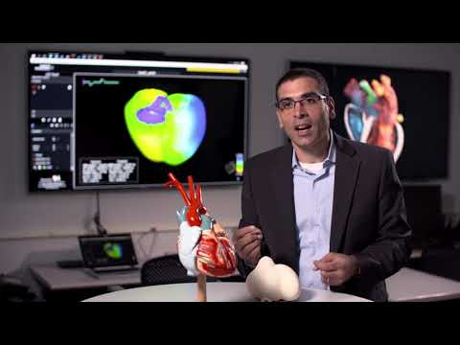
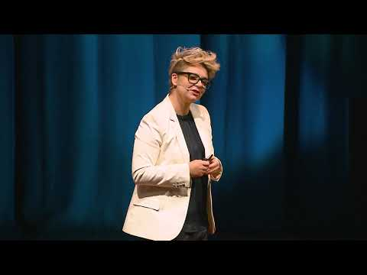
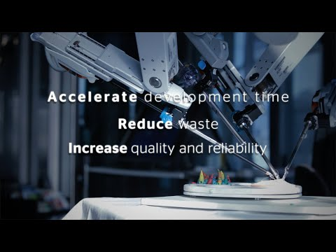

Hope you enjoy them !
Developing a digital twin of the heart
Will your digital twin make you healthier?
Digital twin for smart pharma
Mitigating Racial Disparities with Data Science

Slide 34
Bibliography

Slide 35
Bibliography
Corral-Acero, J., Margara, F., Marciniak, M., Rodero, C., Loncaric, F., Feng, Y., Gilbert, A., Fernandes, J. F., Bukhari, H. A., Wajdan, A., Martinez, M. V., Santos, M. S., Shamohammdi, M., Luo, H., Westphal, P., Leeson, P., DiAchille, P., Gurev, V., Mayr, M., Geris, L., … Lamata, P. (2020). The 'Digital Twin' to enable the vision of precision cardiology. European heart journal, 41(48), 4556–4564. https://doi.org/10.1093/eurheartj/ehaa159
Herwig, Christoph, Ralf Pörtner, and Johannes Möller. “Digital Twins Applications to the Design and Optimization of Bioprocesses.” http://www.springer.com/series/10 (January 9, 2022).
Kamel Boulos, M. N., & Zhang, P. (2021). Digital Twins: From Personalised Medicine to Precision Public Health. Journal of personalized medicine, 11(8), 745. https://doi.org/10.3390/jpm11080745
Kesari, G. 2021. “Meet Your Digital Twin: The Coming Revolution In Drug Development.” Forbes. https://www.forbes.com/sites/ganeskesari/2021/09/29/meet-your-digital-twin-the-coming-revolution-in-drug-development/?sh=7f432b46745f (January 9, 2022).
Lawton, George. 2021. “21 Ways Medical Digital Twins Will Transform Healthcare .” VentureBeat. https://venturebeat.com/2021/07/04/21-ways-medical-digital-twins-will-transform-healthcare/ (January 9, 2022).
Morales Orcajo, Enrique. 2021. “6 Digital Twin Applications in Healthcare – The Revolution of the Next Decade.” Linkedin. https://www.linkedin.com/pulse/6-digital-twin-applications-healthcare-revolution-enrique (January 9, 2022).
Schwartz, S. M., Wildenhaus, K., Bucher, A., Byrd, B. (2020). “Digital Twins and the Emerging Science of Self: Implications for Digital Health Experience Design and “Small” Data“. Frontiers in Computer Science (2) https://www.frontiersin.org/article/10.3389/fcomp.2020.00031
Suomi, Visa. 2021. “Next-Generation Digital Twins in Healthcare.” MedTech Intelligence. https://www.medtechintelligence.com/column/next-generation-digital-twins-in-healthcare/ (January 9, 2022).

Slide 36
Bibliography
Björnsson, B., Borrebaeck, C., Elander, N., Gasslander, T., Gawel, D. R., Gustafsson, M., Jörnsten, R., Lee, E. J., Li, X., Lilja, S., Martínez-Enguita, D., Matussek, A., Sandström, P., Schäfer, S., Stenmarker, M., Sun, X. F., Sysoev, O., Zhang, H., & Benson, M. (2019). Digital twins to personalize medicine. In Genome Medicine (Vol. 12, Issue 1). BioMed Central Ltd. https://doi.org/10.1186/s13073-019-0701-3

Slide 37
Does anyone have any questions?
THANKS

